Slide 1
DBS PROJECT PHASE - 1

Slide 2
TEAM 27
NITIN REDDY K – CS21B2028
MSR PAVAN - CS21B2022
SHANKAR SUBHAN SINGH – CS21B1080
ANANYA M - CS21B2013

Slide 3
CONTENTS
Contribution
Our main page
Our individual webpages
Technologies learned
Challenges

Slide 4
contribution
This is a project of creating our own portfolio/resume.
Main aim : Learning HTML & CSS.
Main page was done by Nitin. And each individual resumes were done on our own.
Learning sources : Various Youtube channels, w3schools, etc
Time spent : on an average of 15 hours.

Slide 5
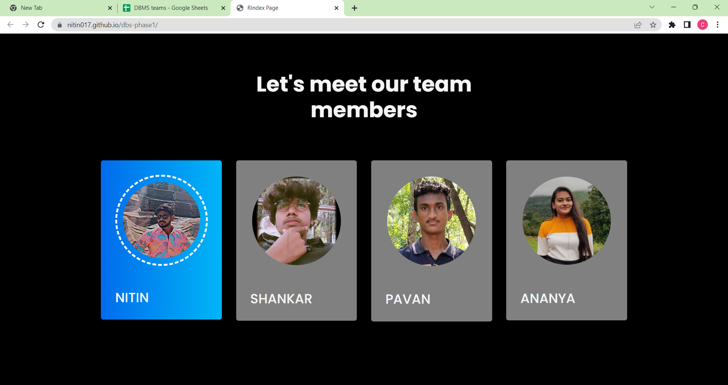
Main page
Card:
We tried to create a card like
structure using section
and gave color to our card using
hover effect.
For image in the card:
We used border-radius feature and created a
rounded image along with dashed border.

Slide 6
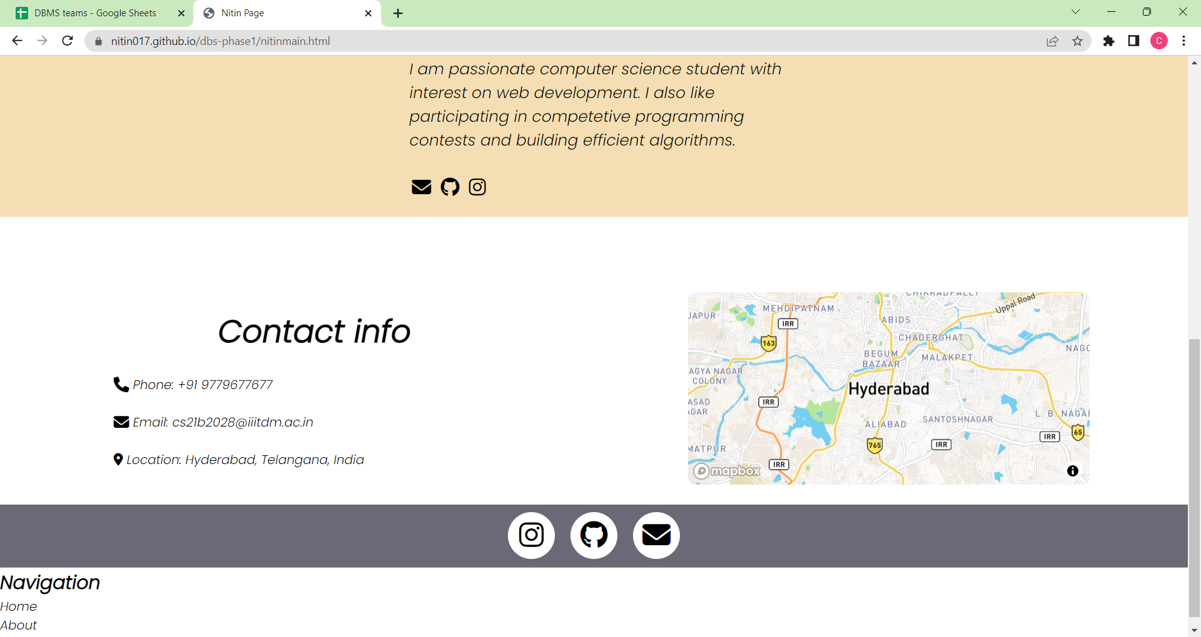
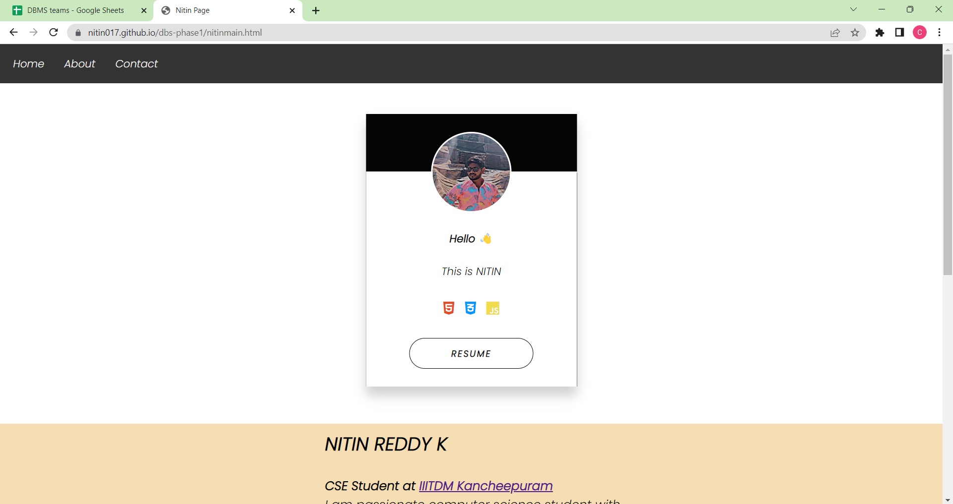
NITIN’S PAGE
Added a black background color to the top navigation
Styled the links inside the navigation bar
and Change the color of links on hoverIn div named
'main-container’.
I had sub divs, and using 'i' tag I added images of languages used
and learnt while doing this.
Also added a simple button to go to resume page and tried color combinations
and little styling to enance the lookIn 'introContainer' div I gave little description of myself and
added few external linksIn 'contactMeContainer' div.
I gave few ways to contact through links also pictorial representations using 'i' tagIn. 'mapContainer',using mapbox I added a map.
In 'popup-logos' div,I gave some socials' links by adding little animation.
Again the footer contained navigation links.

Slide 7
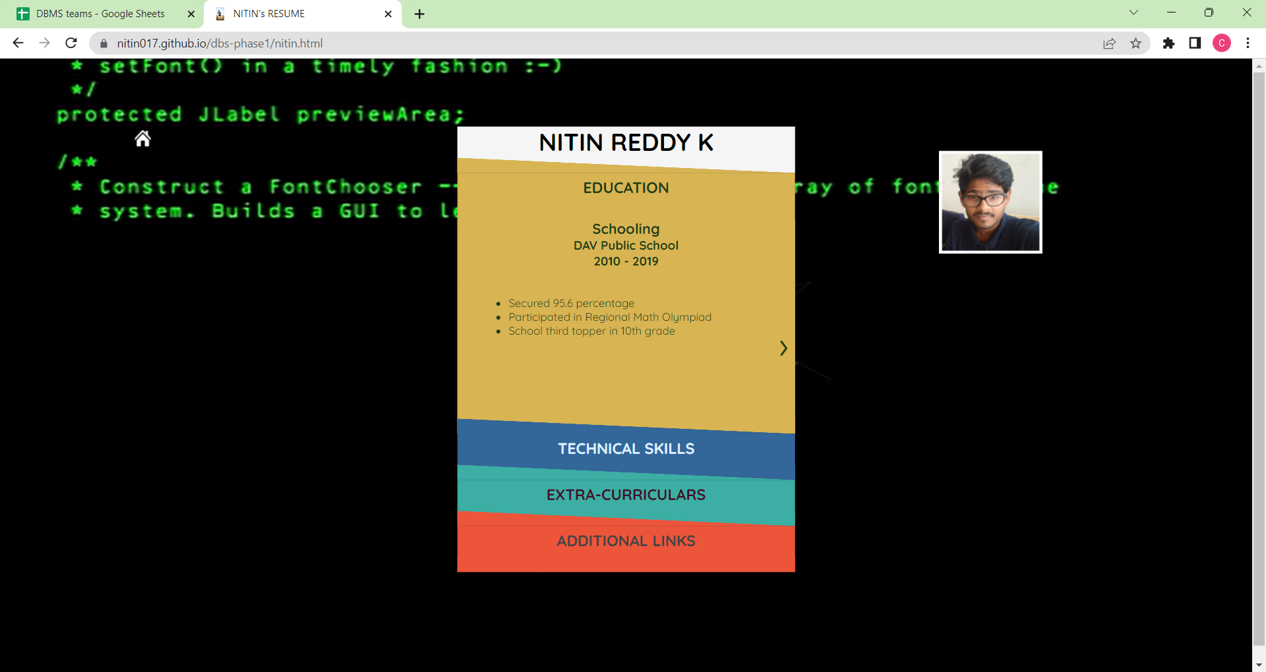
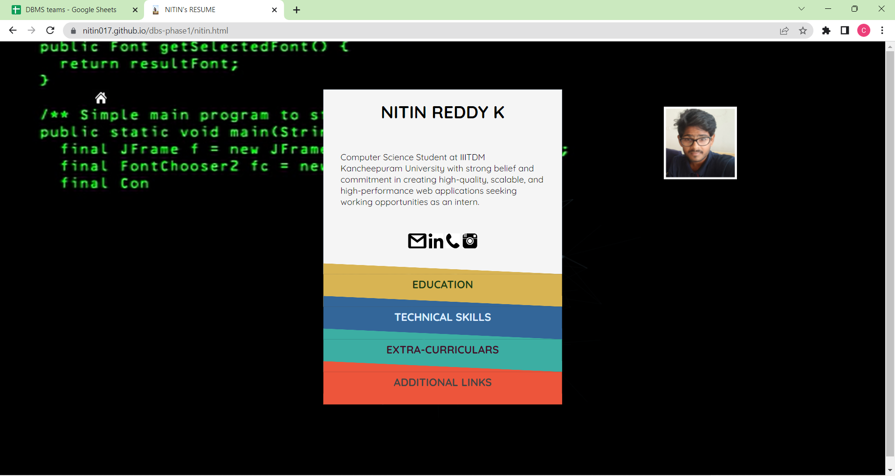
CNTD.
For background I just added a video using canvas
and video tag using input type as radio.
I created different sliding type effect and page type effect
for education partIn header part of the resume part.
I created paragraph and added images containing links to contact me.
In section 'edu-certs’, I have given all academic details from 10th standard to presentIn the next two sections,using unordered list I have given details about technical skills and courses completed and some of my extra-curriculars.
In additional links section,I have given text links using unordered list and added address using 'addres' tagIn.
Another div named profile img, I added some image and adjusted it accordingly.
In most part of the code;lineargradient,transitions,transformation were mainly used.
The JS code includes animation and event handling functions to update the canvas in response to changes in the viewport or scrolling.
The code uses the GreenSock Animation Platform (GSAP) for animationI tried to add 'tweenlite' but it ain't working.

Slide 8
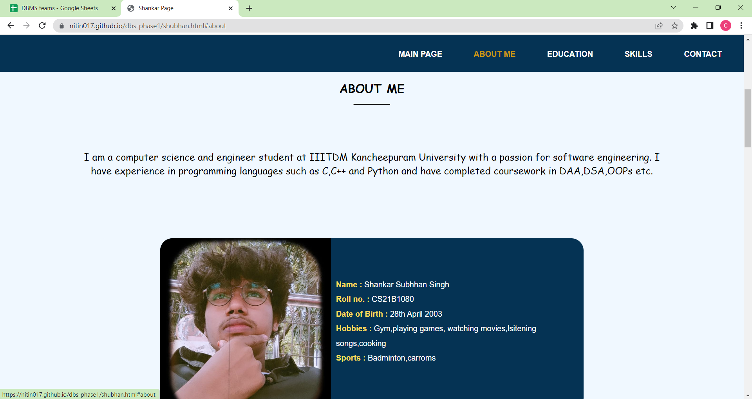
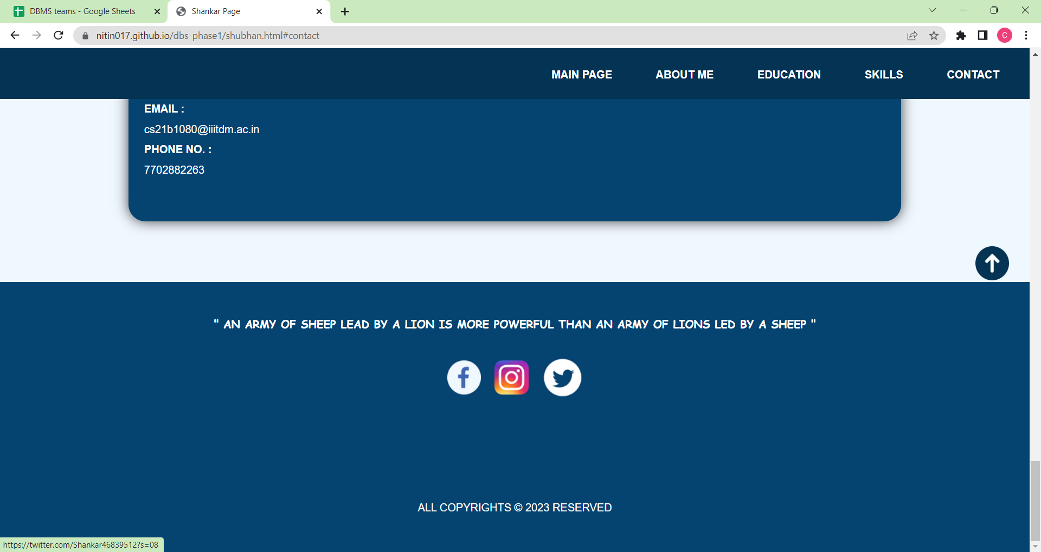
SHANKAR’S PAGE
A navigation bar having internal inks and
a main page link
Followed by different classes named:
about - contains a paragraph stating me
info - having an image of mine and
little details of me in bold
education - starting from school to
current studying college
skills - Wrote about technical and nontechnical in two different div’s
contact - I gave links to contact me.
in footer - In my style i gave a quote to give better opinion on the website in
addition to that, I gave my socials also.

Slide 9
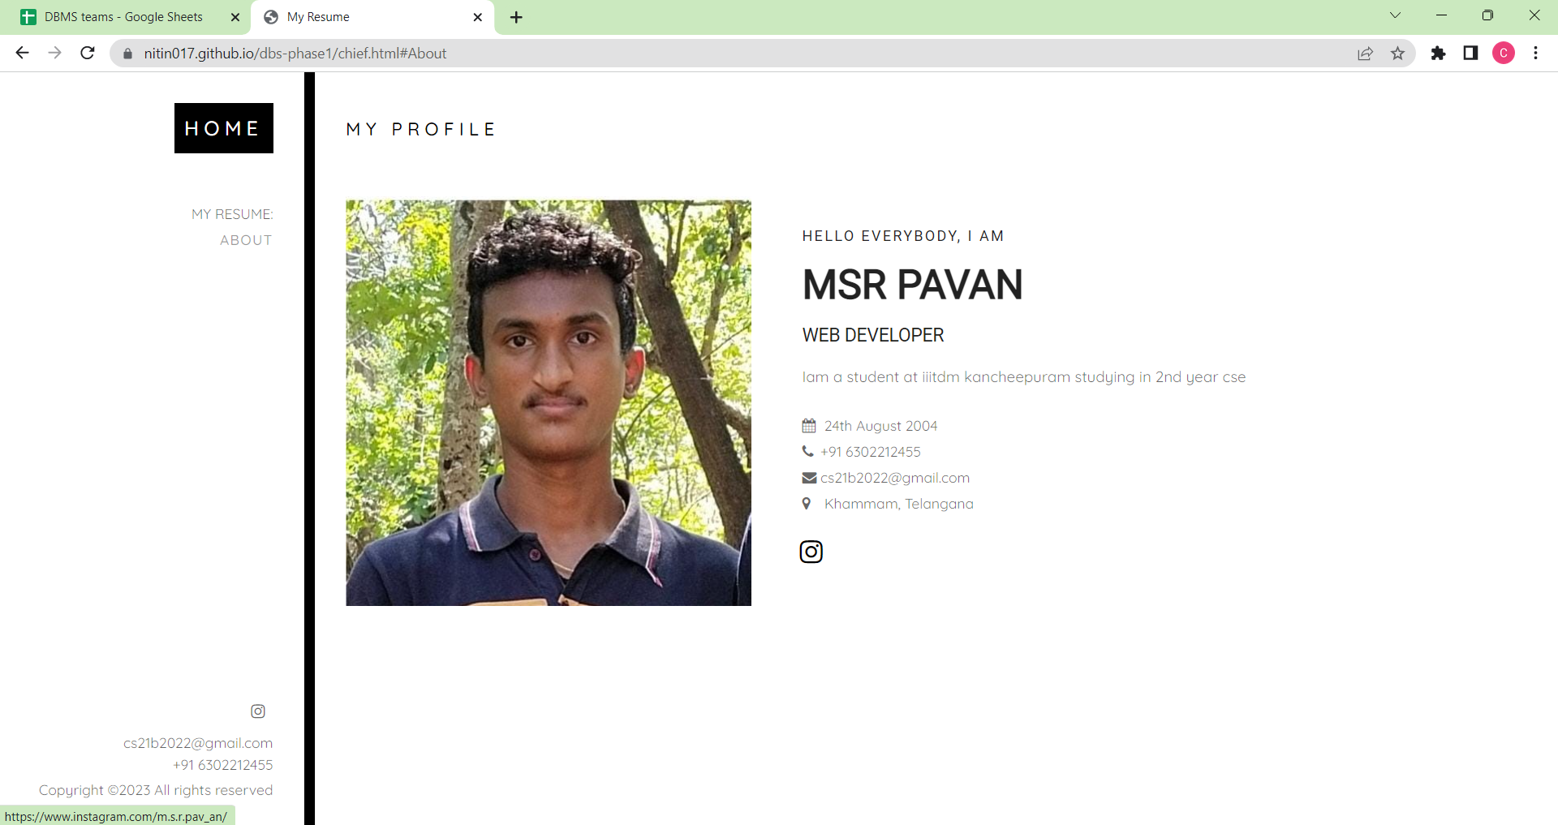
PAVAN’S PAGE
Using different 'div', we made
sections in the page where I
added links which are ordered
and unordered.
In the middle of the page I
added image to enhance the
look of the page.
I added internal and external links.
There is a symbol of copyright(&copy;) in the footer.

Slide 10
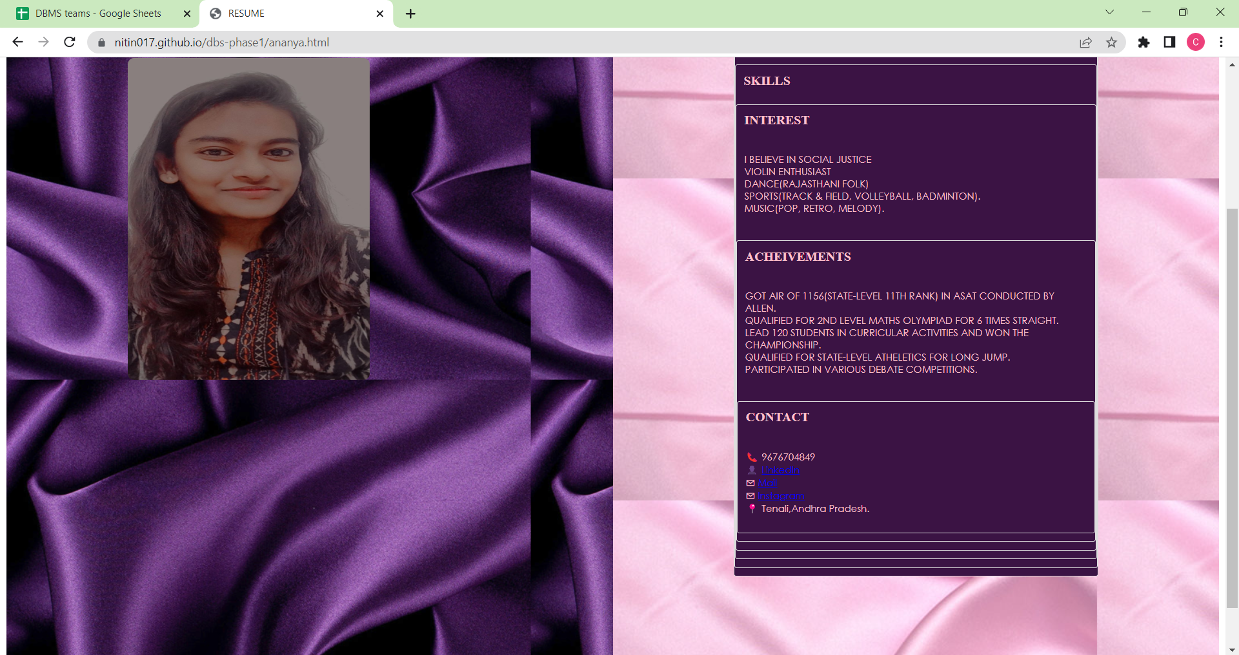
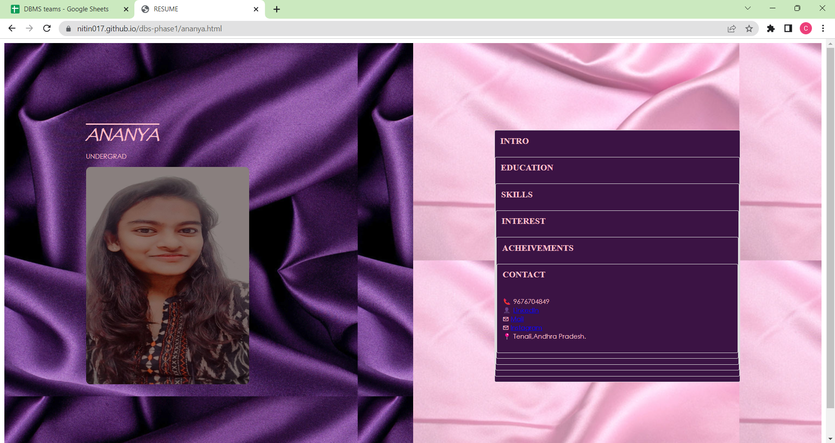
ANANYA’S PAGE
Split screen
Accordian
Sticky image

Slide 11
Technologies
Frameworks:
Frameworks like Bootstrap provide pre-built HTML and CSS components that can
helped speed up development and ensure a consistent look and feel across the
site.
Code editors:
Code editors like Visual Studio Code provided advanced features like syntax
highlighting, autocompletion, and live previews that can help make coding easier and
faster.
Version control systems:
Git can helped us to keep track of changes to our code and collaborate with
others more easily.

Slide 12
Challenges
Dimensions:
Positioning and adjusting divs and images, setting timing of transitions etc were soo
time consuming and exhaustive. This killed most of the time.
User experience:
The user experience (UX) of the website is critical to its success. Users expect a
website to be easy to use and navigate. Poor UX can lead to high bounce rates and
low conversions.

Slide 13
CNTD.
Design consistency:
One of the biggest challenges is maintaining design consistency throughout the website. All
elements of the website, including fonts, colors, and images, should work together
harmoniously to
create a cohesive look and feel.
Visual hierarchy:
Another challenge is creating a visual hierarchy that guides the user's attention and helps
them navigate the website. This requires careful consideration of the placement of design
elements and the use of contrasting colors and font sizes.

